Slide 1

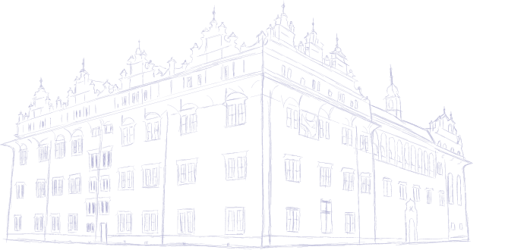

Exoplanet Habitability Prediction Using Machine Learning
By
Name: K. Chandra Shekar Reddy
Degree: B.Tech – Artificial Intelligence
Institution: Vidya Jyothi Institute of Technology
Project Type: Machine Learning & Full-Stack Project

Slide 2
Introduction
Exoplanets are planets outside our solar system
Identifying habitable exoplanets is a major challenge in astronomy
Large astronomical datasets require intelligent analysis
Machine Learning helps identify complex patterns efficiently
This project predicts exoplanet habitability using ML models

Slide 3
Problem Statement
Manual analysis of exoplanet data is time-consuming
Datasets contain missing values and class imbalance
Habitability labels are not always available
Need an automated, accurate prediction system
Need a deployable and user-friendly solution
Objectives
Collect and analyze exoplanet datasets
Clean and preprocess raw data
Engineer meaningful habitability-related features
Build and compare multiple ML models
Predict and rank exoplanets based on habitability
Develop a full-stack application and deploy it

Slide 4
Dataset Description
Data collected from open-source platforms (Kaggle)
Planetary features:
Mass, radius, temperature
Orbital period, distance from star
Stellar features:
Star temperature, luminosity, metallicity
Challenges:
Missing values
No direct habitability labels
Class imbalance
Data Preprocessing
Detected and handled missing values
Removed irrelevant and redundant features
Corrected data types
Outlier detection using boxplots
Feature scaling using standardization
Encoding categorical features

Slide 5
Feature Engineering
Correlation analysis for feature selection
Creation of scientific indices:
Habitability Score Index (HSI)
Stellar Compatibility Index (SCI)
Handling class imbalance using SMOTE
Improved data quality and model performance
Dataset Preparation
Defined target variable:
Binary: Habitable / Non-Habitable
Multi-class: Low, Medium, High habitability
Train–test split (80:20)
Built preprocessing pipelines
Ensured no data leakage

Slide 6
Machine Learning Models Used
Logistic Regression – A linear classification algorithm used as a baseline model for predicting habitability classes.
K-Nearest Neighbors (KNN) – Classifies exoplanets based on similarity to nearby data points.
Support Vector Machine (SVM) – Finds an optimal decision boundary to separate habitable and non-habitable planets.
Decision Tree – Uses a tree-like structure to make decisions based on feature conditions.
Random Forest – An ensemble of multiple decision trees that improves accuracy and reduces overfitting.
XGBoost – A powerful gradient boosting algorithm that handles complex patterns and class imbalance effectively.
Model Evaluation Metrics
Accuracy – Measures the overall correctness of model predictions.
Precision – Indicates how many predicted habitable planets are actually habitable.
Recall – Measures the model’s ability to identify all truly habitable planets.
F1-score – A balanced metric combining both precision and recall.
ROC-AUC – Evaluates the model’s ability to distinguish between classes across thresholds.
Confusion Matrix – Provides a detailed breakdown of correct and incorrect predictions.

Slide 7
Model Comparison & Results
Multiple machine learning models were evaluated to identify the most reliable approach for habitability prediction.
Random Forest and XGBoost achieved the highest overall performance
XGBoost effectively handled class imbalance, improving recall for minority classes
Linear models (Logistic Regression, SVM) showed limited performance on rare habitable cases
Ensemble models demonstrated better generalization on unseen data
XGBoost was selected as the final model based on accuracy, robustness, and consistency
Exoplanet Ranking
After final model selection, exoplanets were ranked using predicted probabilities.
Probability outputs from XGBoost were used for ranking
Exoplanets were sorted based on habitability likelihood
Higher-ranked planets indicate greater potential for habitability
Ranking helps prioritize promising exoplanets for further astronomical research

Slide 8
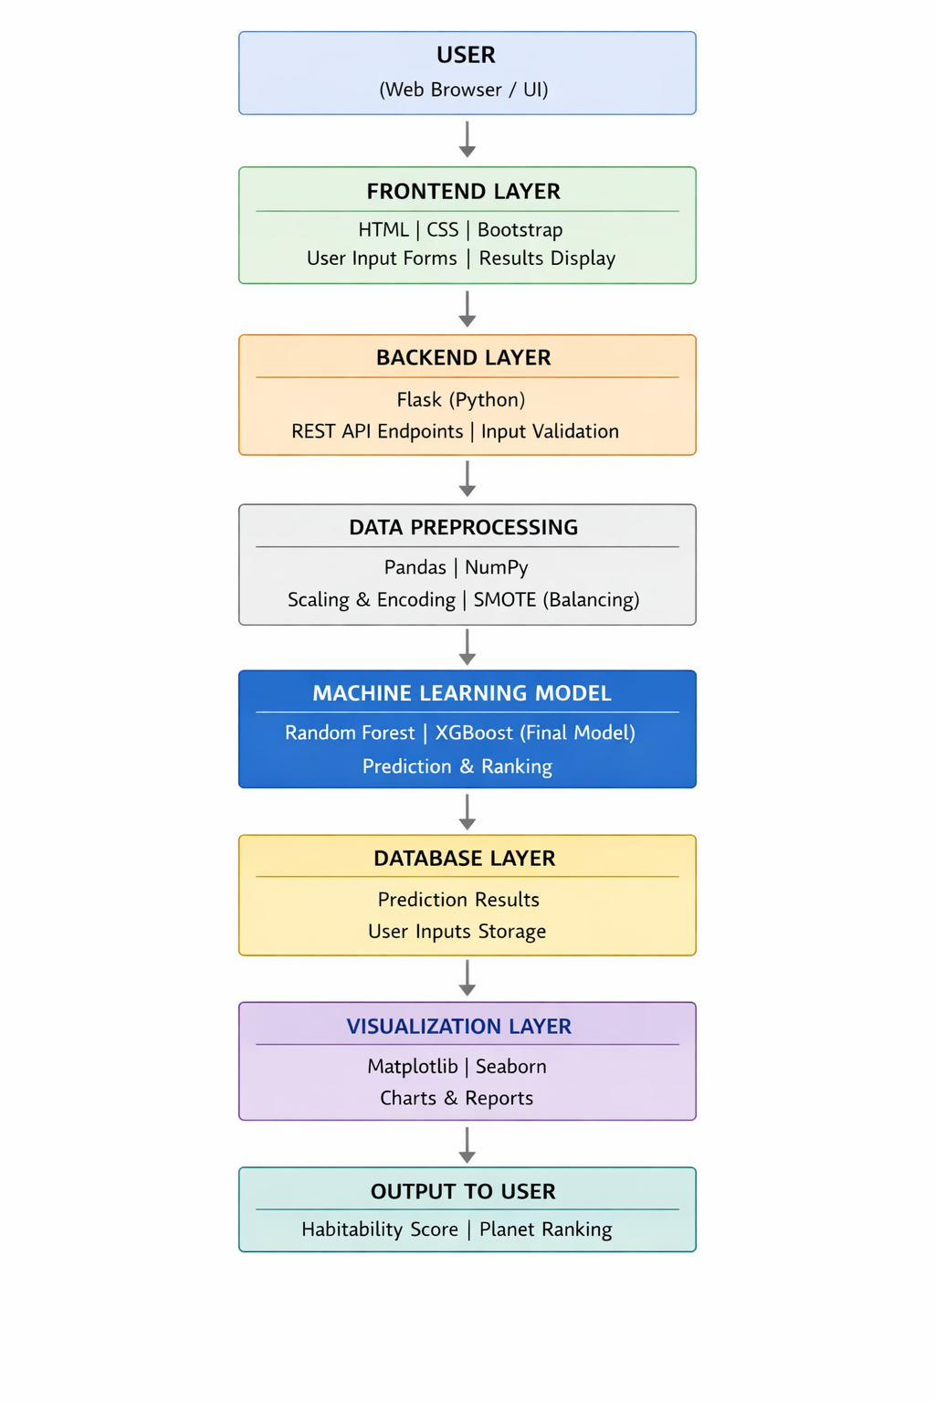
Architecture
Diagram

Slide 9
System Architecture
The project follows a modular and scalable system architecture.
Frontend UI
Built using HTML, CSS, and Bootstrap
Collects user input and displays predictions
Backend API
Developed using Flask
Handles requests, validation, and responses
Machine Learning Model
Trained XGBoost model for prediction and ranking
Database Layer
Stores user inputs and prediction results
Visualization & Deployment
Analytical dashboards and cloud-based deployment

Slide 10
Deployment & Visualization
The system is fully deployed with interactive visualization support.
Flask REST APIs enable real-time habitability prediction
Interactive frontend interface for user-friendly input
Visualization dashboard includes:
Feature importance analysis
Habitability score distribution
Correlation analysis between parameters
Deployed on cloud platform for public access
Reports exported in PDF and Excel formats

Slide 11
Challenges Faced
1
2
Incomplete and Noisy Data
Class Imbalance
Datasets contain missing values and inconsistent records.
Habitable planets are significantly fewer than non-habitable ones
3
4
Complex Feature Relationships
Model Generalization
Habitability depends on multiple interacting parameters.
Ensuring reliable performance on unseen exoplanet data.

Slide 12
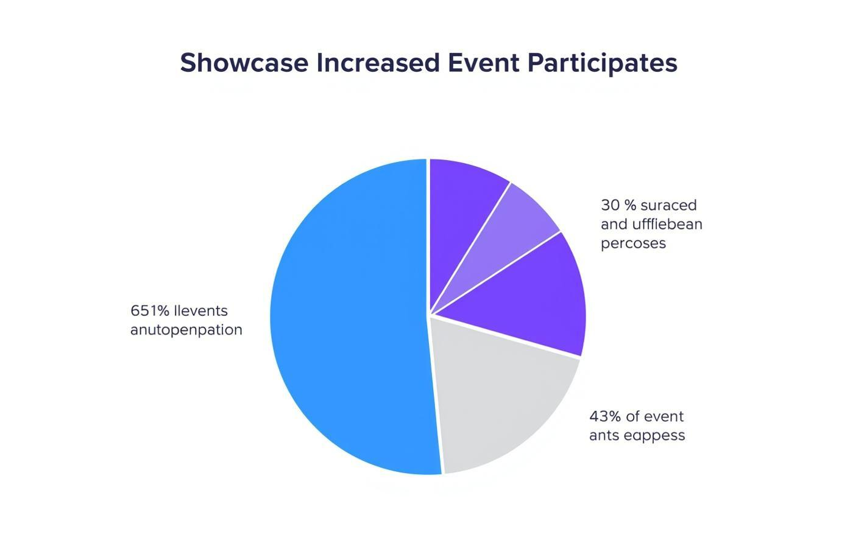
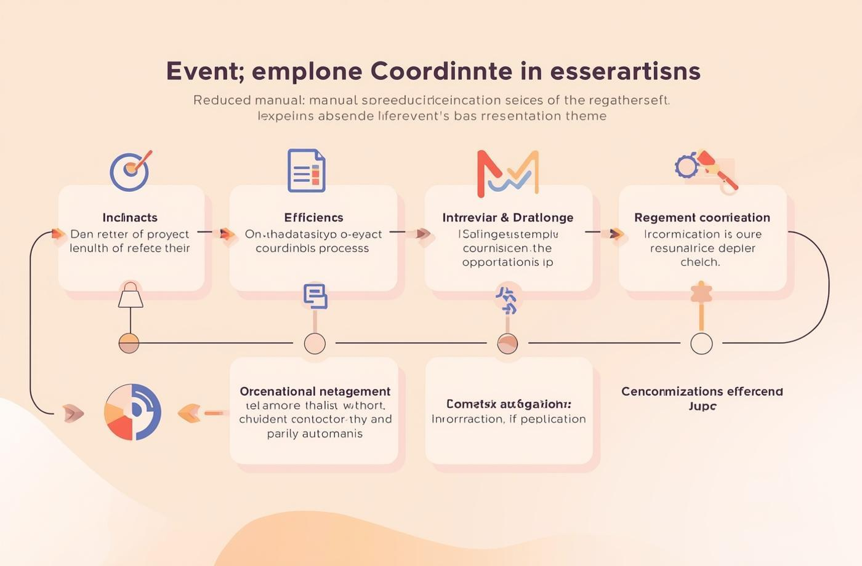

Measurable Outcomes and Positive Impact
Effective Class Imbalance Handling
Accurate Planet Ranking
End-to-End System Implementation – Integrated ML, backend APIs, frontend UI, and deployment.
Improved Prediction Accuracy
Scientific and Practical Relevance

Slide 13
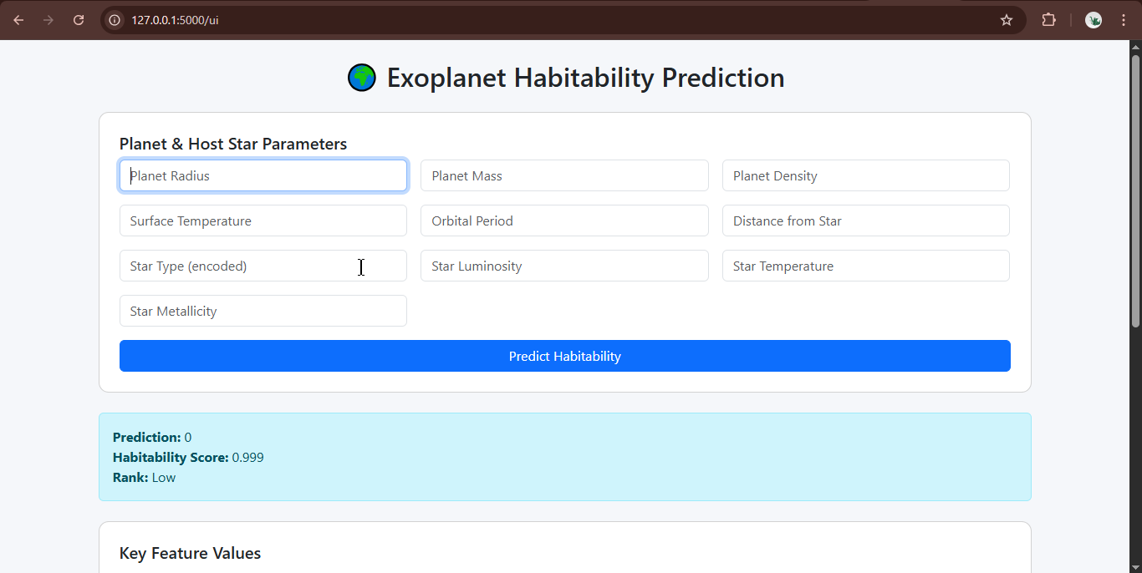
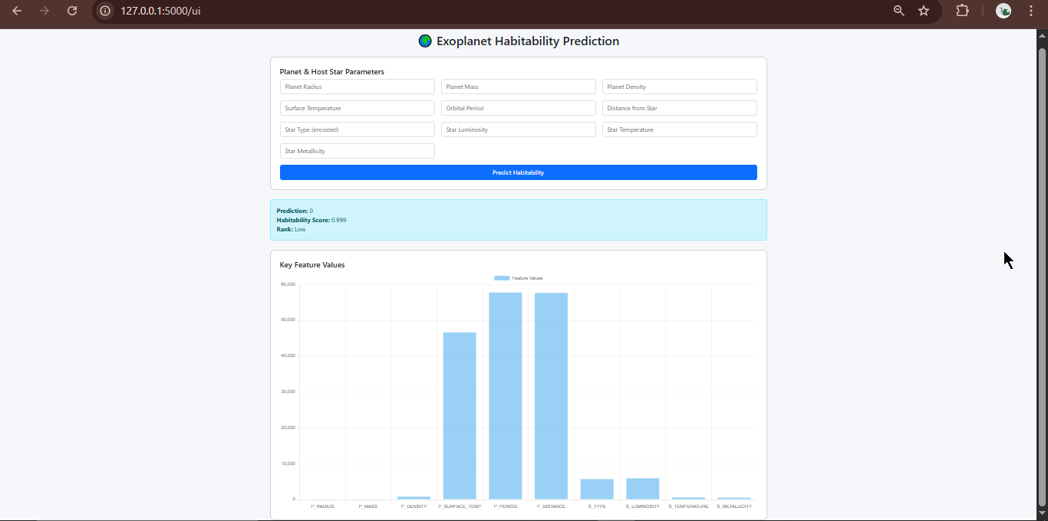
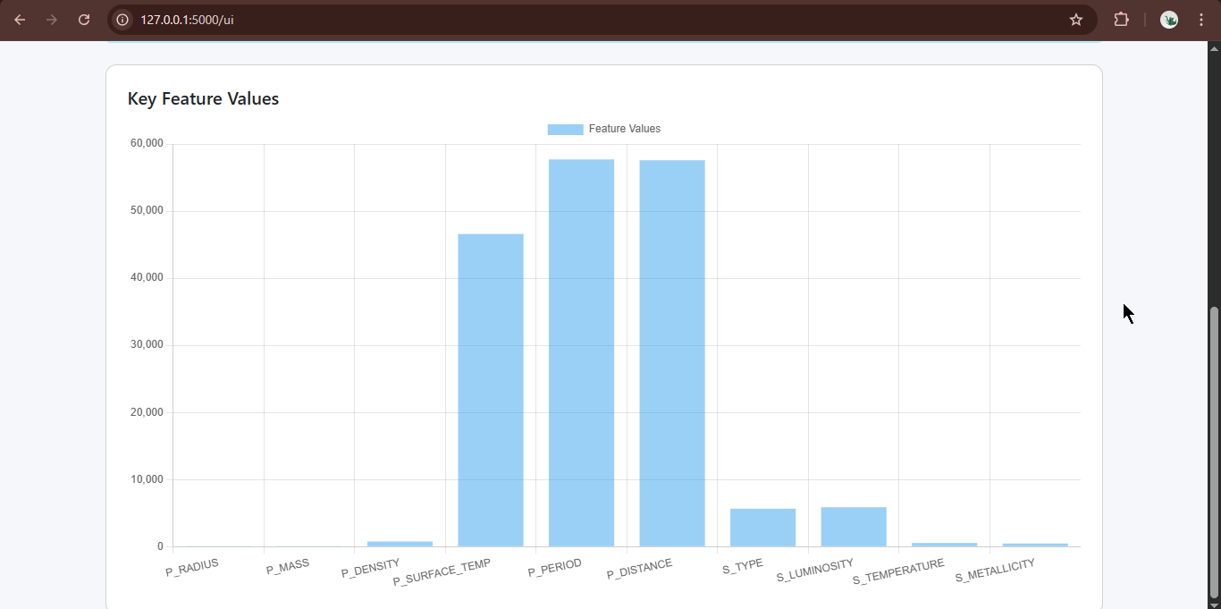

Slide 14
CONCLUSION
This project successfully demonstrates the application of machine learning and full-stack development to solve a real-world scientific problem. By integrating data preprocessing, advanced ML models, REST APIs, interactive UI, visualization dashboards, and cloud deployment, the system provides a scalable and efficient solution for exoplanet habitability prediction.
The project reflects strong practical skills in data science, machine learning, backend and frontend development, and deployment, making it a comprehensive and impactful AI-based solution.
Successfully developed a complete end-to-end machine learning system
Achieved accurate habitability prediction and exoplanet ranking
Integrated ML models, backend APIs, frontend UI, visualization, and deployment
Delivered a production-ready full-stack solution

Slide 15
Live Link...
https://habitability-of-exoplanets-hl2e.onrender.com/

Slide 16

Thank You

